Slide 1

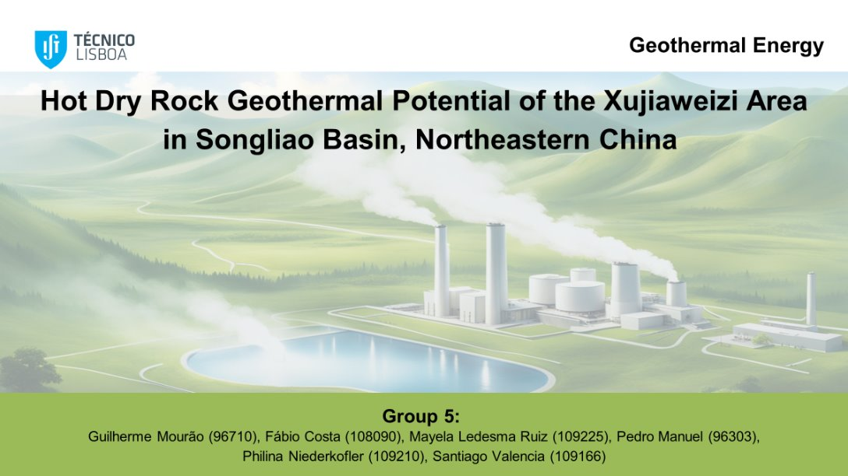
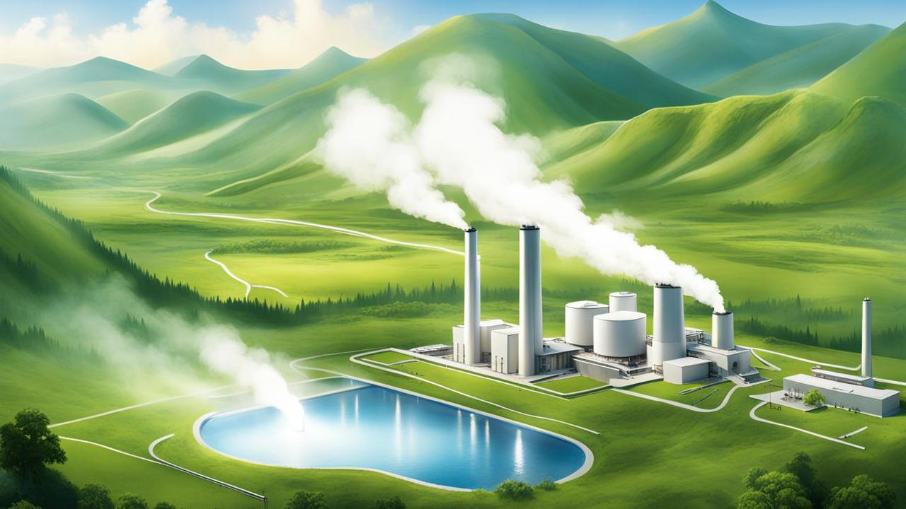
Geothermal Energy
Hot Dry Rock Geothermal Potential of the Xujiaweizi Area in Songliao Basin, Northeastern China
Group 5:
Guilherme Mourão (96710)
Fábio Costa (108090)
Mayela Ledesma Ruiz (109225)
Pedro Manuel (96303)
Philina Niederkofler (109210)
Santiago Valencia (109166)

Slide 2
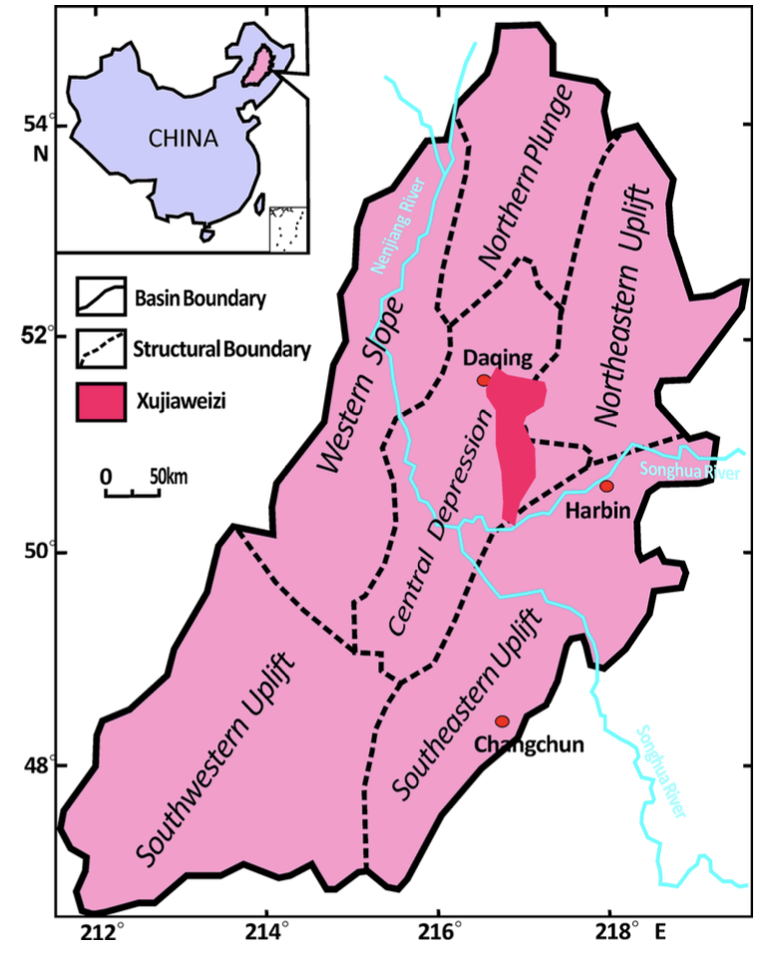
Geological Setting
Geological characteristics
Mesozoic-Cenozoic sedimentary basin formed on a folding basement
Terrestrial strata: volcanic, volcaniclastig, sedimentary rocks
Basement: Middle Jurastic granites and Paelozoic strata
XJWZ area: upper depression layer and lower fault depression
Fig 2: Location of Songliao Basin and XJWZ, showing major structural zones in the basin (Guo et al.,2016)

Slide 3
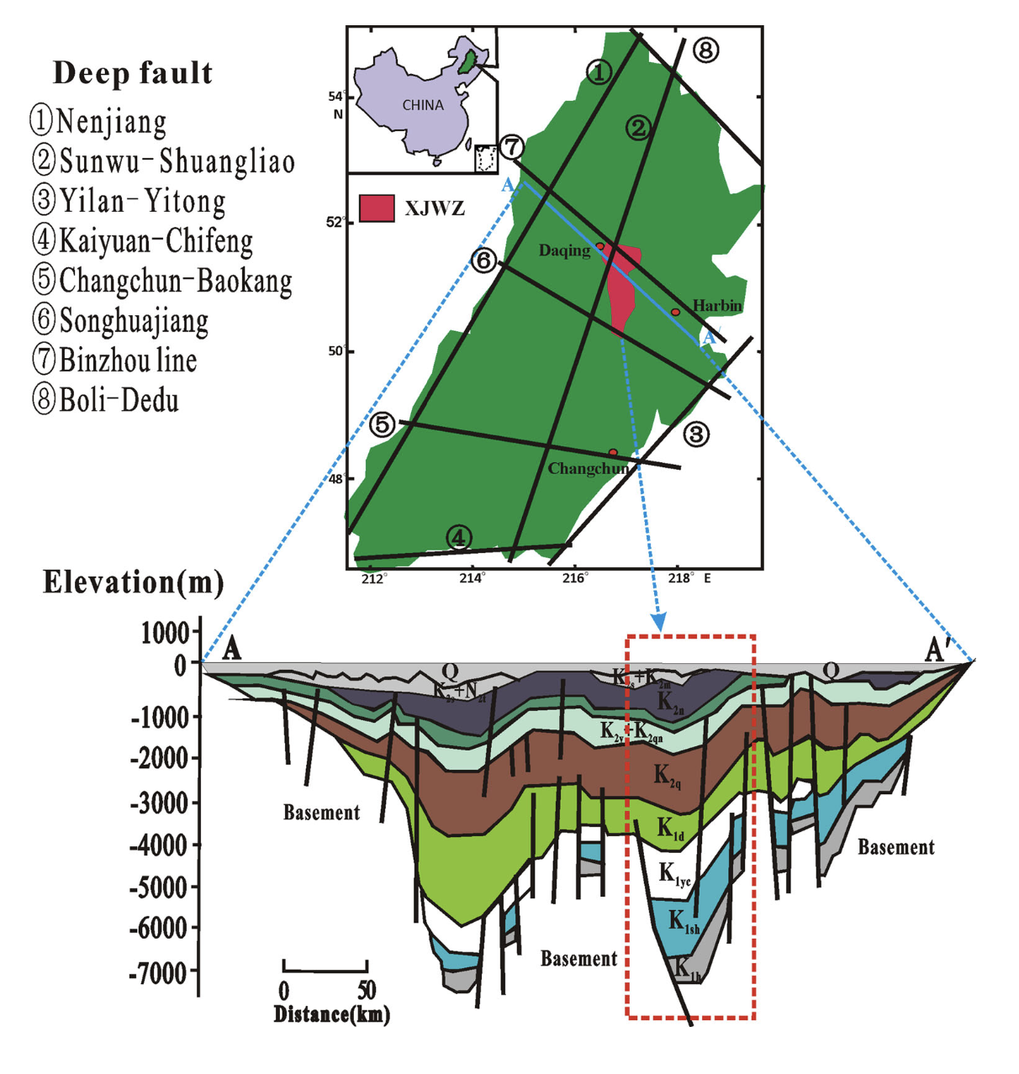
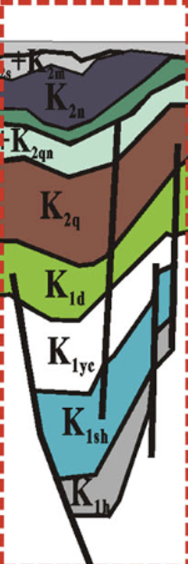
Geological Setting
Lower fault depression
Target reservoir for the HDR resource development
Denglouku group (K1d): 200m thick silt mudstone cap rock for deep geothermal energy
Yingchen group (K1yc): Thick acid volcanic rock layers
Fig 3: Schematic map of deep faults and stratigraphic cross sections in the Songliao Basin (Guo et al.,2016)
-

Slide 4
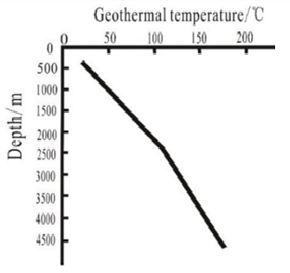
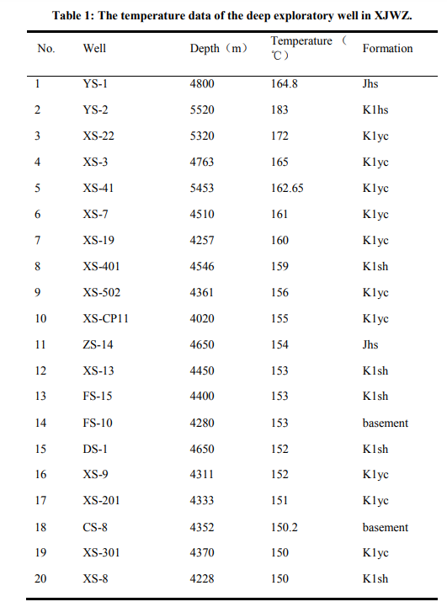
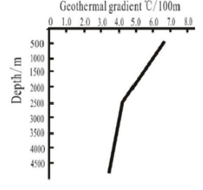
Geothermal Field
Geothermal Temperature and Gradient
Data from oil and gas exploratory wells in Daqing Oilfield;
“Linear” correlation between temperature and depth;
Turning point in the fault-depression transition;
Geothermal gradient : 3.9 – 6.5 (ºC/100m)
Fig 4: Variation of geothermal temperature and gradient with depth (Guo et al.,2015)
(Guo et al.,2015)

Slide 5
The average crustal thickness of XJWZ is only 29 km, which is caused by the crust extensional thinning and upper mantle uplift. As a result of the subduction of the Pacific plate under the Eurasian plate, the Songliao Basin suffered a strong tension function that enhances thermal activity.
Heat Source
Heat Source
The Songliao Basin suffered a strong tension function that enhances thermal activity.

Slide 6
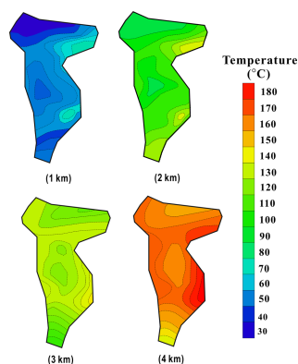

Geothermal Field
Geothermal Temperature and Gradient
Temperature distribution at different depths
Depth [m] | Temperature Range [ºC ] | Average Temperature [ºC]
1000 | 39 – 60 | 48
2000 | 75 – 140 | 96
3000 | 108 – 136 | 121
4000 | 144 – 18 | 162
(Guo et al.,2015)
(Guo et al.,2015)

Slide 7
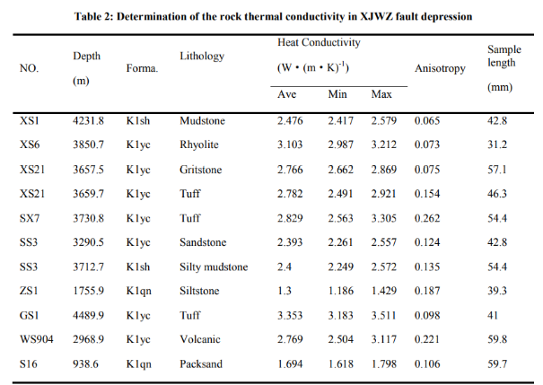
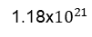
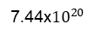
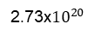
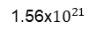
Geothermal Field
Rock thermal properties
11 rock samples from the XJWZ fault depression;
Thermal/Heat conductivy comparison.
Magmatic Sedimentary
HDR resource evaluation
Volume method
Energy [J] | Depth [km]
 | 0 – 1
 | 1 – 2
 | 2 – 3
 | 3 – 4
2.73x${10}^{20}$
7.44x${10}^{20}$
1.18x${10}^{21}$
1.56x${10}^{21}$
Magmatic
(Guo et al.,2015)
(Guo et al.,2015)
Sedimentary

Slide 8
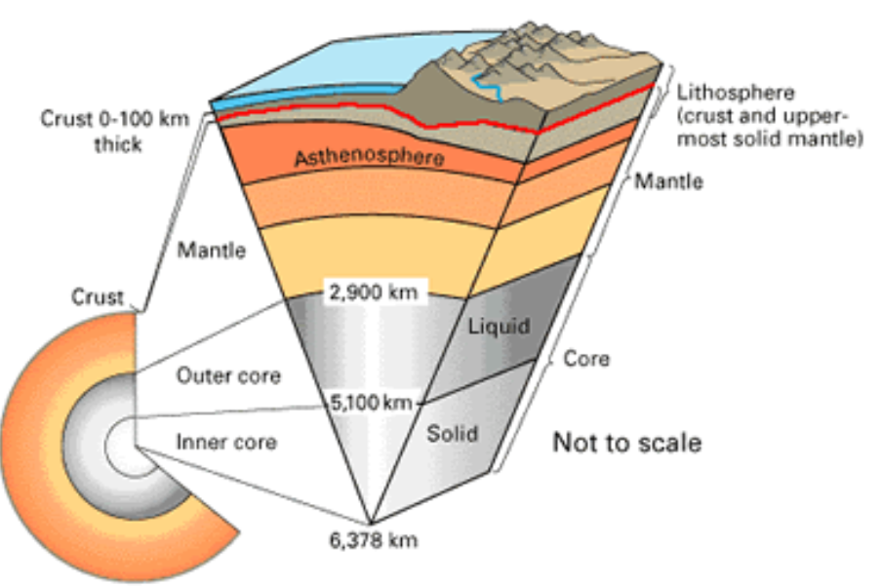
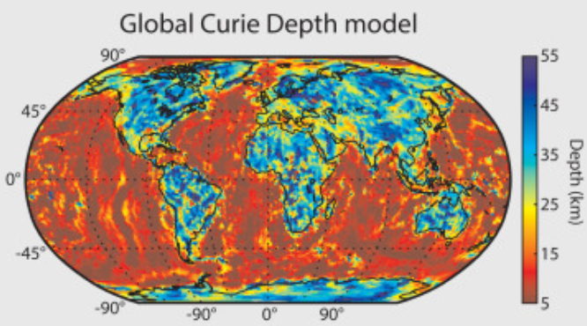
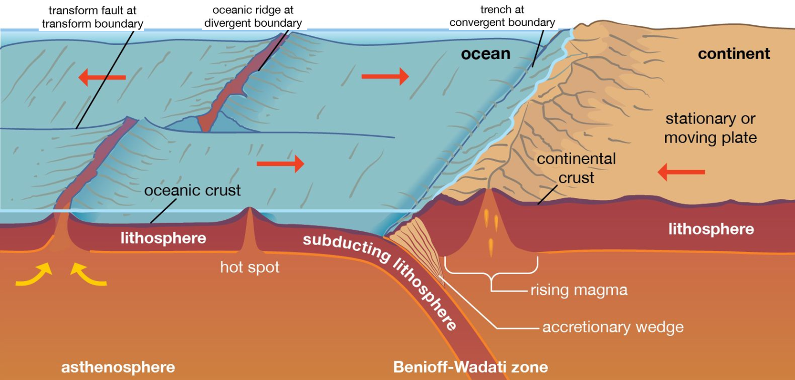
Geophysics
Moho Surface Depth: From 29 to 36 km, controlling the geothermal field of the region. The shallowest part of the Moho is near the XJWZ area, at a depth of 29-30 km.
Crustal Structure and Plate Tectonics: Strong tectonic forces due to the subduction of the Pacific plate under the Eurasian plate.
High-Conductivity Layer: Is 2-5 km thick (20 km deep), is found in the basin. Low resistivity and low density.
Magma Chamber as Heat Source: Likely a magma chamber resulting from mantle intrusion into the crust. The main heat source for the basin.
Fig 6: Earth's core and Moho line representation
Curie Surface Depth: At 10-24 km, the shallowest region being also near the XJWZ area at 10-12 km, indicating high potential geothermal resources.
Fig 7: Curie depth globally
Fig 8: Representation of tectonic plate movements and consequences

Slide 9
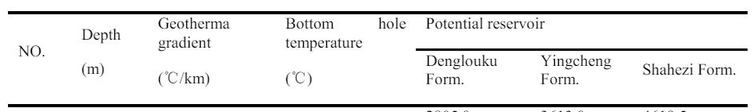
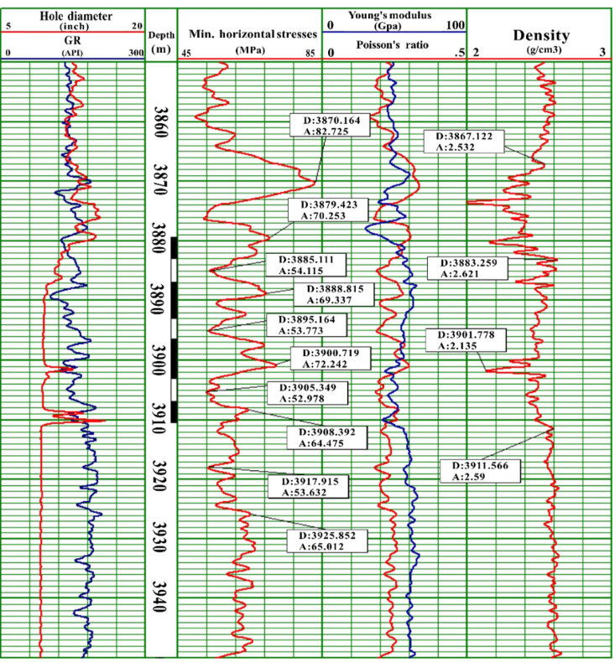
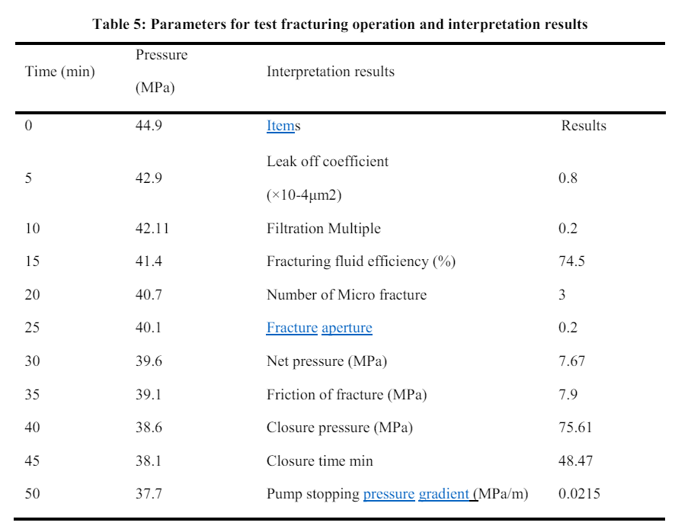
Geophysics fracture testing
Key: Geophisical parameters of the region;
Where: Deepest well, YS2;
Little water: Dense lithology mall porosity, very thick rock;
Low pore width: less than 0.2 mm, rich natural cracks;
Yingchen temperature: 150℃-200℃.
(Guo et al.,2015)
(Guo et al.,2015)

Slide 10
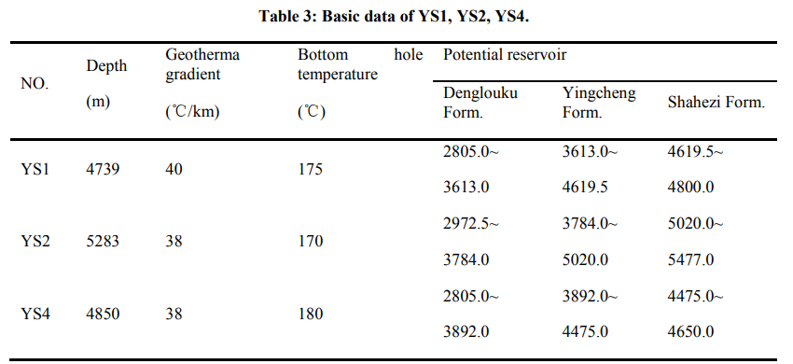
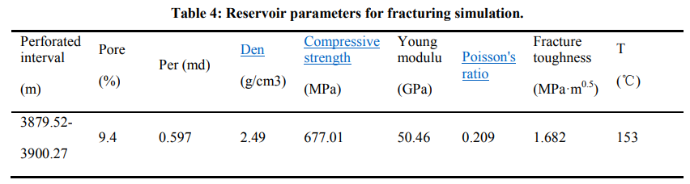
Reservoir Studies
Target reservoir
Physical properties
Volcanic reservoir in Yingcheng group has little water
Ancient sedimentary water
Rich natural fracture
Reservoir stimulation
In-situ stress gradient is 0.0246 MPa/m
(Guo et al.,2015)

Slide 11
References
Guo, L., Zhang, Y., Yu, Z., Hu, Z., Chengyu, L., & Xu, T. (2015). Feasibility Evaluation of EGS Project in the Xujiaweizi Area: Potential Site in Songliao Basin, Northeastern China.Proceedings World Geothermal Congress.https://www.geothermal-energy.org/pdf/IGAstandard/WGC/2015/31028.pdf
Guo, L., Zhang, Y., Yu, Z., Hu, Z., Chengyu, L., & Xu, T. (2016). Hot dry rock geothermal potential of the Xujiaweizi area in Songliao Basin, northeastern China. Environmental Earth Sciences, 75(6). https://doi.org/10.1007/s12665-016-5327-9
Multi-stage Texas geothermal well to debut oilfield completion technologies. (n.d.). https://www.worldoil.com/magazine/2022/may-2022/special-focus-well-completion-technology/multi-stage-texas-geothermal-well-to-debut-oilfield-completion-technologies/
Zhang, L., Chen, S., & Zhang, C. (2019). Geothermal power generation in China: Status and prospects. Energy Science & Engineering, 7(5), 1428–1450. https://doi.org/10.1002/ese3.365
Zhang, Y., Li, Z., Guo, L., Gao, P., Jin, X., & Xu, T. (2014). Electricity generation from enhanced geothermal systems by oilfield produced water circulating through reservoir stimulated by staged fracturing technology for horizontal wells: A case study in Xujiaweizi area in Daqing Oilfield, China. Energy, 78, 788–805. https://doi.org/10.1016/j.energy.2014.10.073

Slide 12
Thank you for
your attention!

